Slide 1
Modelling Colombian Economy: Stock-Flow Consistent Prototype Growth Model
An adaptation from Yilmaz & Godin (2020).

Slide 2
Structure of the presentation.
Discussion about last meeting comments: FX loans, portfolio flows, consumption tax, households equities, and labour productivity.
Summary of the final version of the model.
Once the model is in the code, what alternatives scenarios to include.

Slide 3
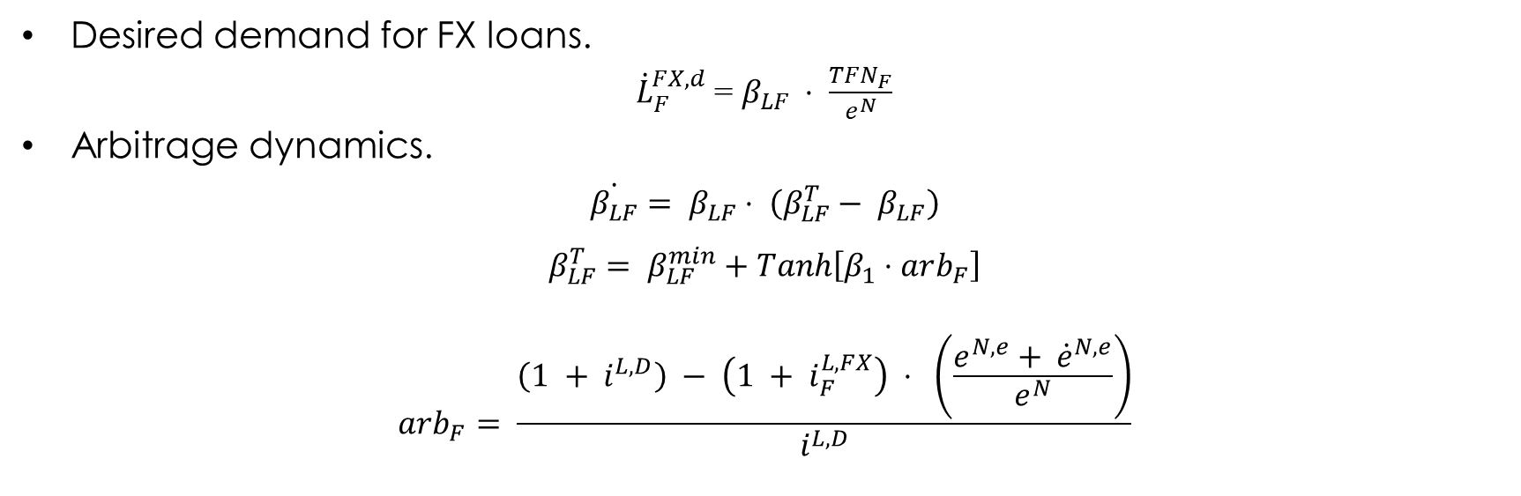
FX loans – Demand.
Desired demand for FX loans.
${\dot{L}}_{F}^{FX,d}$ = $β_{LF} ⋅ \frac{TFN_{F}}{e^{N}}$
Arbitrage dynamics.
$$\dot{β_{LF}}= β_{LF}⋅ \left(β_{LF}^{T}− β_{LF}\right)$$
$$β_{LF}^{T}= β_{LF}^{min}+Tanh\left[β_{1}⋅arb_{F}\right]$$
$$arb_{F}= \frac{\left(1 + i^{L,D}\right) − \left(1 + i_{F}^{L,FX}\right) ⋅ \left(\frac{e^{N,e}+ {\dot{e}}^{N,e}}{e^{N}}\right)}{i^{L,D}}$$

Slide 4
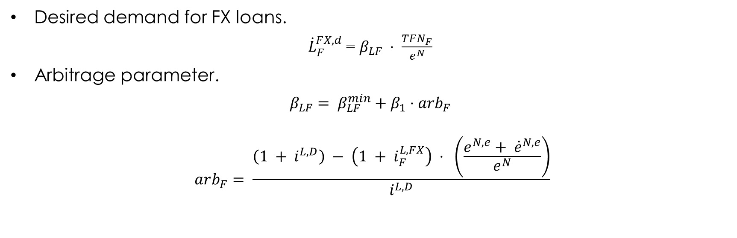
FX loans – New Arbitrage Dynamic.
Desired demand for FX loans.
${\dot{L}}_{F}^{FX,d}$ = $β_{LF} ⋅ \frac{TFN_{F}}{e^{N}}$
Arbitrage parameter.
$$β_{LF}= β_{LF}^{min}+β_{1}⋅arb_{F}$$
$$arb_{F}= \frac{\left(1 + i^{L,D}\right) − \left(1 + i_{F}^{L,FX}\right) ⋅ \left(\frac{e^{N,e}+ {\dot{e}}^{N,e}}{e^{N}}\right)}{i^{L,D}}$$

Slide 5

Firms FX loans – Supply.
Credit rationing mechanism applied by the international banks:
${\dot{L}}_{B}^{FX,d}= {\dot{L}}_{F}^{FX,d}$
$${\dot{L}}_{B}^{FX}= {χ∙\dot{L}}_{B}^{FX,d}$$
$$χ= χ_{0}+χ_{1}∙NIIP+ χ_{2}∙\frac{\dot{GDP}}{GDP}$$
Interest rate on FX loans charged to the domestic banks
$i_{B}^{L,FX}= \left(1+θ\right)i^{W}$
$$θ= θ_{0}∙risk$$

Slide 6

Portfolio Flows – Option A.
Portfolio flows entering to the economy
$$WFF^{D}= ψ∙{\dot{B}}_{G}/e^{N}$$
$$ψ=ψ_{min}+ψ_{1}∙\left(r^{B,e}−r^{W, e}\right)$$
$$r_{G}^{B,e}= \frac{\left(1 +i_{G}^{B} \right)\left(1 − rsk\right)}{\left(\frac{e^{N,e} + {\dot{e}}^{N,e}}{e^{N}}\right)}$$
$$r^{W,e}=1+i_{G}^{W}$$
New Government bonds purchased by the rest of the world.
$${\dot{B}}_{G}^{W}=WFF^{D}∙e^{N}$$

Slide 7

Portfolio Flows – Option B.
Global portfolio flows.
$$WFF=Φ⋅GDP_{W}⋅p_{W}$$
Portfolio flows entering to the economy.
$$WFF^{D}=ψ_{WFF}⋅WFF$$
$$ψ_{WFF}=ψ_{min}+ψ_{1}∙\left(r^{B,e}−r^{W, e}\right)$$
$$r_{G}^{B,e}= \frac{\left(1 +i_{G}^{B} \right)\left(1 − rsk\right)}{\left(\frac{e^{N,e} + {\dot{e}}^{N,e}}{e^{N}}\right)}$$
$$r^{W,e}=1+i_{G}^{W}$$
New Government bonds purchased by the rest of the world.
$${\dot{B}}_{G}^{W}=WFF^{D}∙e^{N}$$

Slide 8
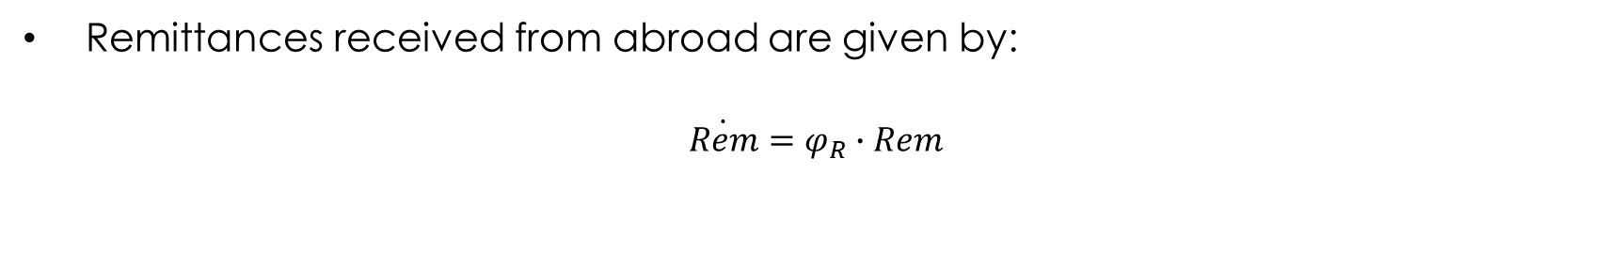
Remittances.
Remittances received from abroad are given by:
$$\dot{Rem}=φ_{R}∙Rem$$

Slide 9
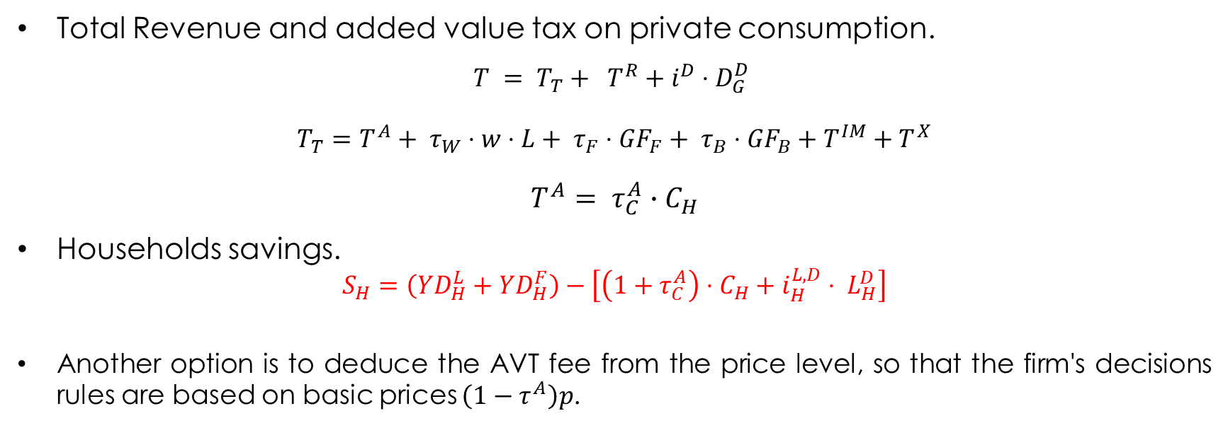
Government.
Total Revenue and added value tax on private consumption.
$$T = T_{T}+ T^{R}+i^{D}⋅D_{G}^{D}$$
$T_{T}=T^{A}+ τ_{W}⋅w⋅L+ τ_{F}⋅{GF}_{F}+ τ_{B}⋅{GF}_{B}+T^{IM}+T^{X}$
$$T^{A}= τ_{C}^{A}∙C_{H}$$
Households savings.
$$S_{H}=\left(YD_{H}^{L}+YD_{H}^{F}\right)−\left[\left(1+τ_{C}^{A}\right)⋅C_{H}+i_{H}^{L,D}⋅ L_{H}^{D}\right]$$
Another option is to deduce the AVT fee from the price level, so that the firm's decisions rules are based on basic prices $\left(1−τ^{A}\right)p$.

Slide 10
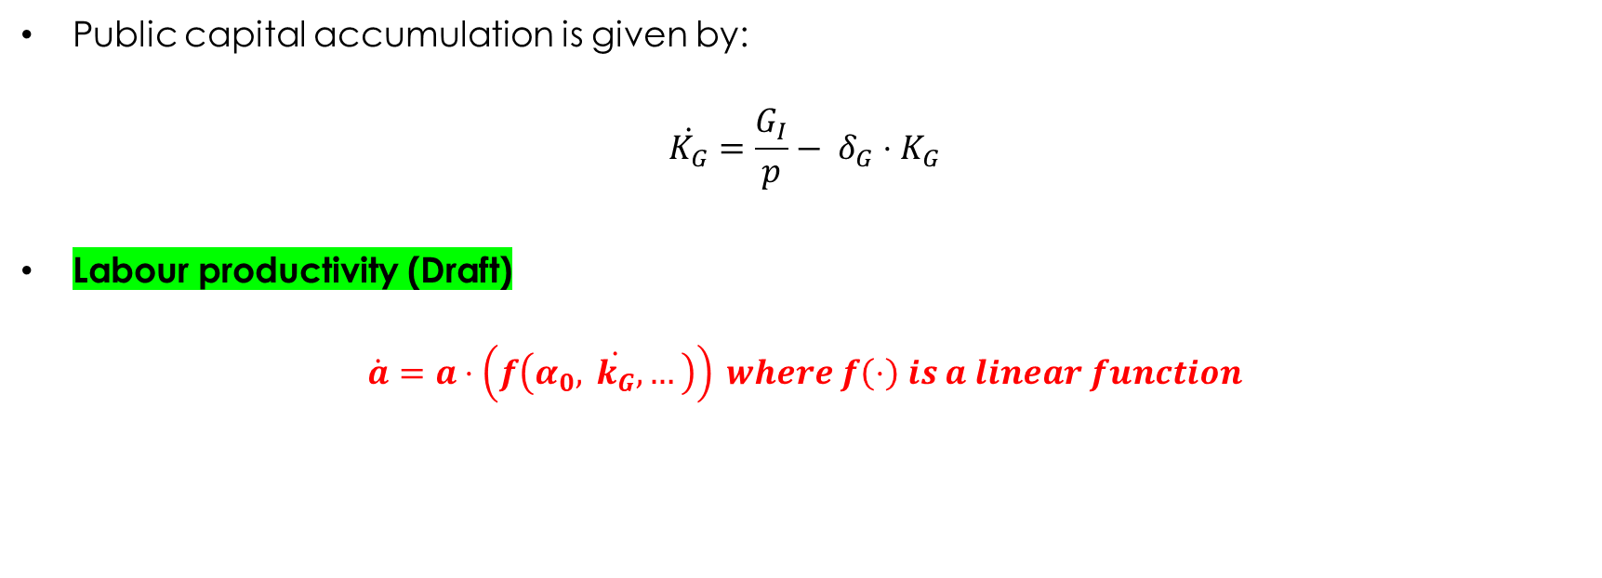
Public Investment.
Public capital accumulation is given by:
$$\dot{K_{G}}=\frac{G_{I}}{p}− δ_{G}⋅K_{G}$$
Labour productivity (Draft)
$$\dot{a}=a⋅\left(f\left(α_{0}, \dot{k_{G}},…\right)\right) where f\left(⋅\right) is a linear function$$

Slide 11
Summary.
Households loans demand.
Accelerator effect into the investment equation.
Central Bank does not purchase government bonds.
Feedback between labour productivity and public investment.
Government monetary transfers linked to a share of total population.
More detailed tax structure: consumption tax and royalties (proxy)
Autonomous exports.

Slide 12
Summary.
Foreign Direct Investment: added into the investment equation and as a new funding source.
Further modifications to the external sector dynamics:
Credit rationing mechanism in cross border lending flows.
Simpler arbitrage parameters in FX loans demand and portfolio flows.
Exogenous FDI flows.
Exogenous growth rate of remittances.
Possibility of introducing scenarios.

Slide 13
Scenarios.
Benchmark Model:
Foreign policy rate.
World GDP growth rate.
Foreign inflation rate.
Colombian adaptation:
Lower exports and remittances growth.
Lower portfolio and FDI flows.
Greater CBL rationing
Sensitivity analysis.
Exchange rate adjustment.
Fundamentals and risk perception.
Greater households loans elasticity.
Greater sensitivity to arbitrage gaps.
Change in FDI allocation.
Elasticity of productivity to Public Investment.

